Slide 1




Chapter 8:
The challenges of our time and Protocol Labs's work
Beginners Guide to Filecoin
Content created by Brown Zhang
Researcher @ KEN Labs

Slide 2
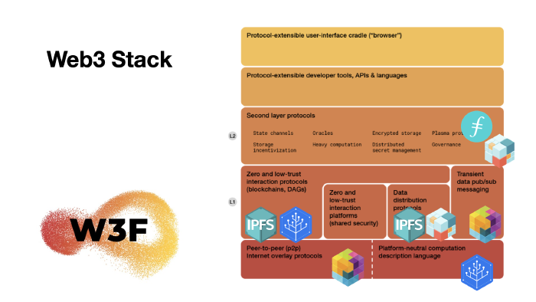
What is Protocol Labs
Protocol Labs exists to enable a network of projects, tools, startups, research, communities (and more) that are springing up and evolving around new protocols and web3 technologies. As this ecosystem grows, these projects invest in the network itself, and the network grows along with it, which in turn benefits and incentivizes this ongoing evolution.
The Project Stack:

Slide 3
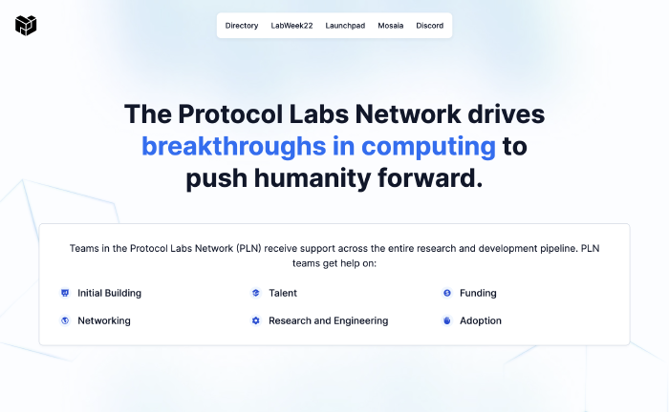
The Protocol Labs Network
This portal is the central point of reference for all the resources available to PLN members.
Protocol Labs Portal: https://www.plnetwork.io/
An explorable ecosystem directory for ipfs and filecoin:
IPFS Ecosystem Explorer: https://ecosystem.ipfs.io/
Filecoin Ecosystem Explorer: https://ecosystem.filecoin.io/

Slide 4
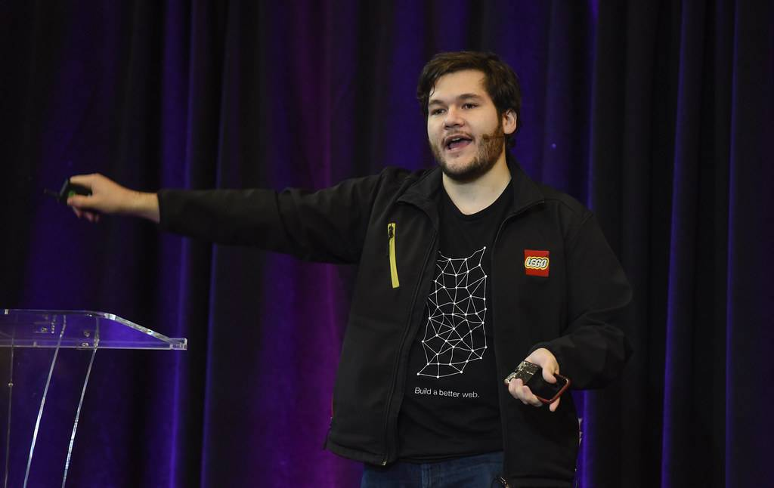
Protocol Labs Culture
Protocol Labs is building the next generation of the internet. We are an open-source Network that spans the research to development pipeline to create new protocols, tools, and services to radically improve the internet. Our products serve thousands of organizations and millions of people.
Many teams in the PL Network are fully distributed and follow a common set of open source practices to grow and flourish together. This distributed, open source philosophy is at the core of how we operate.

Slide 5
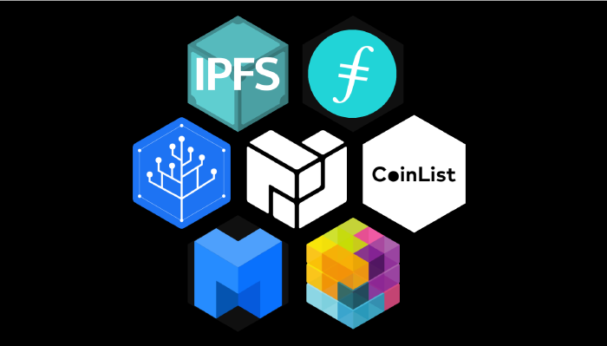
Where We are Headed
Principles
We should improve the internet and computing generally.
We should accelerate the ideas-to-superpowers pipeline.
Build around Market Protocols
The attention and interests of the protocol developers remain aligned with successful outcomes for the protocol, and the projects building around it.

Slide 6
Open Source Stewardship
Protocol Labs: An Open Source Organization
IPFS, libp2p, Filecoin, Multiformats, IPLD, and others are all projects created and sponsored by the PL Network. Each of these projects is an independent open source project, and each of them has needs and goals that span multiple organizations within and outside the PL Network.
Managing Roles
The tricky part in being an employee of a PL Network company, and a member of a project with its own independent goals, is not conflating the two in a way that is harmful to the community.
Communication methods
Sync Comms & Async Comms

Slide 7
Open Source Contribution
The Protocol Labs OSS Projects:IPFS,IPLD,libp2p and Filecoin
PL Repos:Kubo(formerly go-ipfs), libp2p, ipfs-cluster, js-ipfs,multiformats, js-libp2p, Filecoin Improvement Requests(FIPs)
Graphical/ User Interfaces:IPFS Desktop, IPFS Web UI, IPFS Companion
Docs:IPFS docs, libp2p docs,IPLD docs, Filecoin docs,Lotus docs
Dashboards:See this dashboard for go-ipfs projects and tickets
How to Contribute? Greate PRs. Related Links： https://youtu.be/A9Lo_rLNU9w

Slide 8
Conclusion
Open Source Software is at the core of Protocol Labs.

Slide 9


Feedback is welcomed.
https://github.com/kenlabs/Beginners-Guide-to-Filecoin

